Slide 1
http://gofalcons.edmodo.com/home

Slide 2
When TEACHER Signs In…

Slide 10
When STUDENTS Sign Up

Slide 19
Edmodo Affords Teachers Opportunities for Global Collaborating and Networking

Slide 27
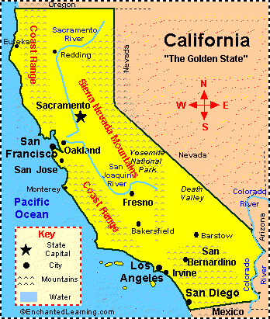
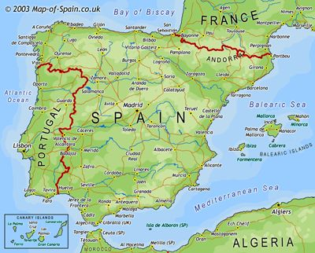
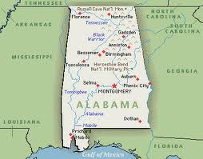
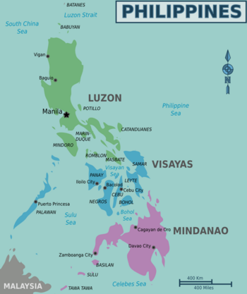
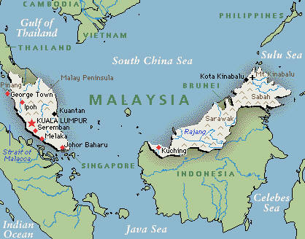
Collaborative Projects for My Students
Dr. Sáez López ,
Culteral Historical
Literature Project
Mrs. Petty,
Mission Viejo, CA
“6 Word Memoir”;
Bloggers: Editing Writing Project
Ms. Bailey,
Putrajaya, Malaysia
Film Festival Project;
The Odyssey
Rebecca Mannah--ad,
San Juan, Philippines
Digital Storytelling: The Story Behind the Story

Slide 28
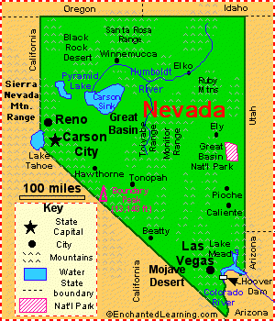
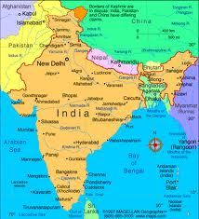
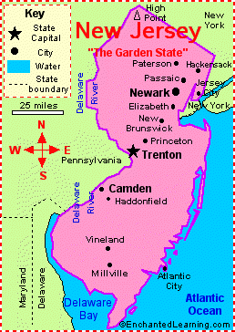
Collaborative PLN Projects
Ms. Nigam,
Mr. LaPorte,
Los Vagas Nevada
Hyderabad, India
Mrs. Baker,
Manahawkin, NJ

